Slide 1
Fractional Dynamics in Physical Science
Conrad Ho
Presented for Partial Fulfilment of Bachelor’s of Science

Slide 2
Objectives
History of Fractional Calculus (FC)
Preliminaries
Memory Effect
Application in Physics
Future of FC and its application to Physics

Slide 3
A Brief History of Fractional Calculus
From Leibniz To Us
Notes:
2 mins

Slide 4
Leibniz’s Letter in 1695
Informal letter to L’Hoptial
Question:
What if the differentiation/integration order is non-integral arbitrary number?
What is half derivatives!? 3/2 integrals!? π order derivative!?

Slide 5
Timeline (not to scale)
1832
Riemann–Liouville
1868
Grünwald–Letnikov
1967
Caputo
2002
‘Fractional Schrodinger equation’ (L. Naskin)
2008
Fractional vector calculus and fractional Maxwell’s equations (V. Tarasov)
2011
‘Fractional dynamics: applications of fractional calculus to dynamics of particles, fields and media’ (V. Tarasov)
2015
Caputo–Fabrizio
2023
‘Experimental realisations of the fractional Schrödinger equation in the temporal domain’ (S. Liu et al.)
1695
Leibniz’s Letter
Notes:
Most research in this topic is done in the last century!

Slide 6
Fractional Calculus 101
A crash course in basics of FC
Notes:
15 mins

Slide 7
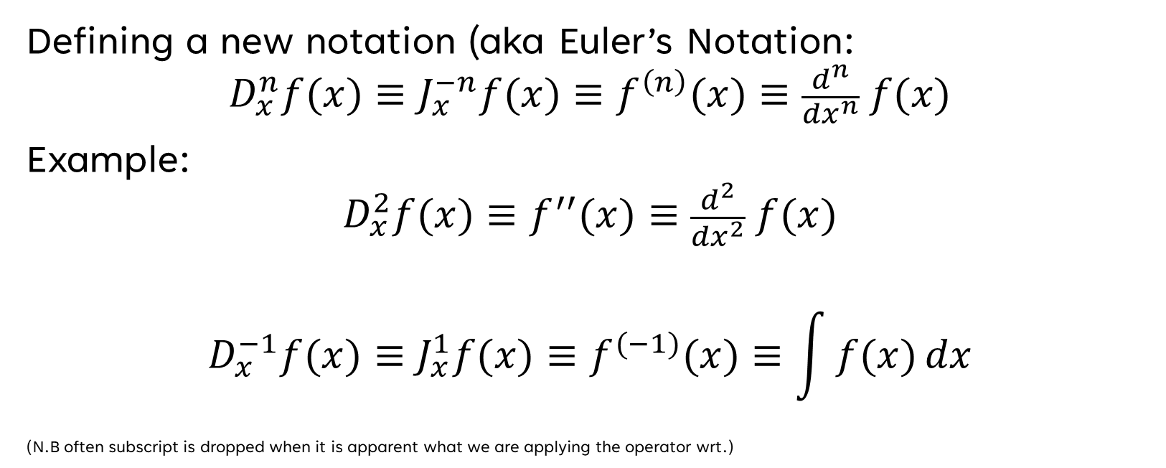
Euler’s Notation
Defining a new notation (aka Euler’s Notation:
$$D_{x}^{n}f(x)≡J_{x}^{−n}f(x)≡f^{\left(n\right)}(x)≡\frac{d^{n}}{{dx}^{n}} f(x)$$
Example:
$$D_{x}^{2}f(x)≡f^{′′}(x)≡\frac{d^{2}}{{dx}^{2}} f(x)$$
$$D_{x}^{−1}f(x)≡{J_{x}^{1}f(x)≡f}^{(−1)}(x)≡\int{f(x)}dx$$
(N.B often subscript is dropped when it is apparent what we are applying the operator wrt.)

Slide 8

The Curious Question
$$D_{x}^{n}f(x)≡J_{x}^{−n}f(x)≡f^{\left(n\right)}(x)≡\frac{d^{n}}{{dx}^{n}} f(x)$$
‘What if n is not an integer ($n∉ ℚ$)?’
Notes:
Ask audience if they think it is easier to generalise derivative or integrals first

Slide 9
The starting point
Intuition:
Derivatives are more “well behaved” → Start by generalising derivatives
Reality…?
(often cruel…)
No :D

Slide 10


The starting point
Cauchy formula for repeated integration:
→ Only works for $n∈ℕ$ b.c. factorial is undefined otherwise!

Slide 11
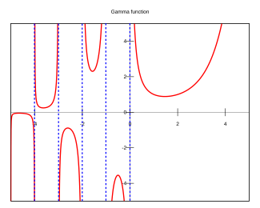

A neat ‘trick’
Gamma function:
$$\text{Γ}\text{(}\text{n}\text{) = (}\text{n}\text{−1)!}$$
Generally, well defined for n>0

Slide 12

Back to the drawing board…
We generalise the formula from:
To:
Where α is now the order of integral
(can be fraction!)

Slide 13

Back to the drawing board…
For $α=n, α∈ℕ$, we just recover:
i.e the “Classical Case”
Very useful property that we will use to verify results later on!

Slide 14

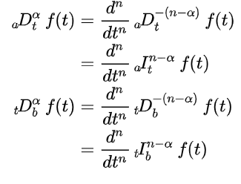


Toolbox
From that fundamental, we can derive:
Caputo Derivative
Caputo–Fabrizio Derivative
RL Derivative
(‘left hand’ and ‘right hand’)
Riesz derivative

Slide 15
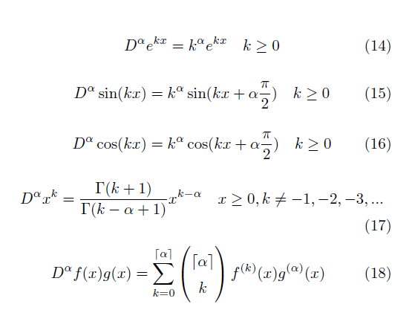

Standard Results:
From that fundamental, we can derive:

Slide 16
The Physics Bits
SHO, Memory Effect and Schrodinger
Notes:
15 mins

Slide 17
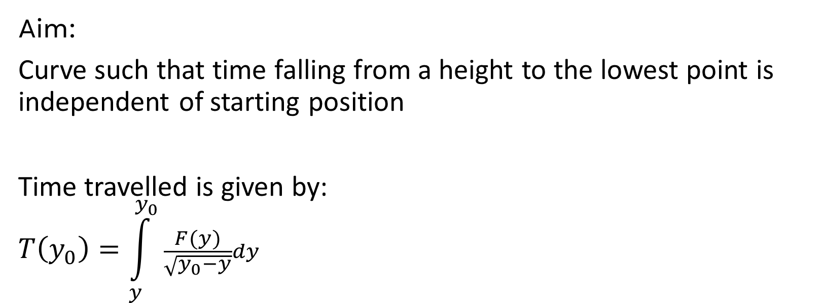
Tautochrone
Aim:
Curve such that time falling from a height to the lowest point is independent of starting position
Time travelled is given by:
$$T\left(y_{0}\right)=\int_{y}^{y_{0}}{\frac{F(y)}{\sqrt{y_{0}−y}}dy}$$
Looks familiar?
Source:
https://en.wikipedia.org/wiki/Tautochrone_curve

Slide 18

Applying FC…
Time travelled is given by:
$$T\left(y_{0}\right)=\int_{y}^{y_{0}}{\frac{F(y)}{\sqrt{y_{0}−y}}dy}$$
Recall:

Slide 19
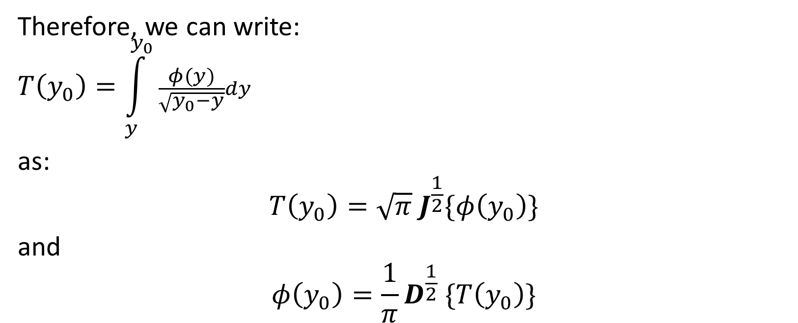
Tautochrone using FC
RL Integral Definition:
Therefore, we can write:
$$T\left(y_{0}\right)=\int_{y}^{y_{0}}{\frac{φ(y)}{\sqrt{y_{0}−y}}dy}$$
as:
$$T\left(y_{0}\right)=\sqrt{π}{ J}^{\frac{1}{2}}\{φ\left(y_{0}\right)\}$$
and
$$φ\left(y_{0}\right)=\frac{1}{π}D^{\frac{1}{2}} \{T\left(y_{0}\right)\}$$

Slide 20
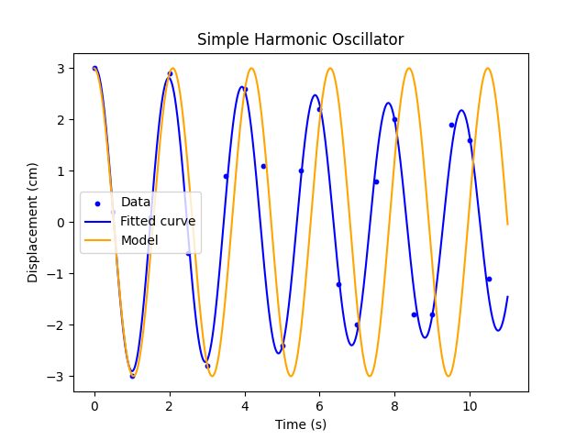
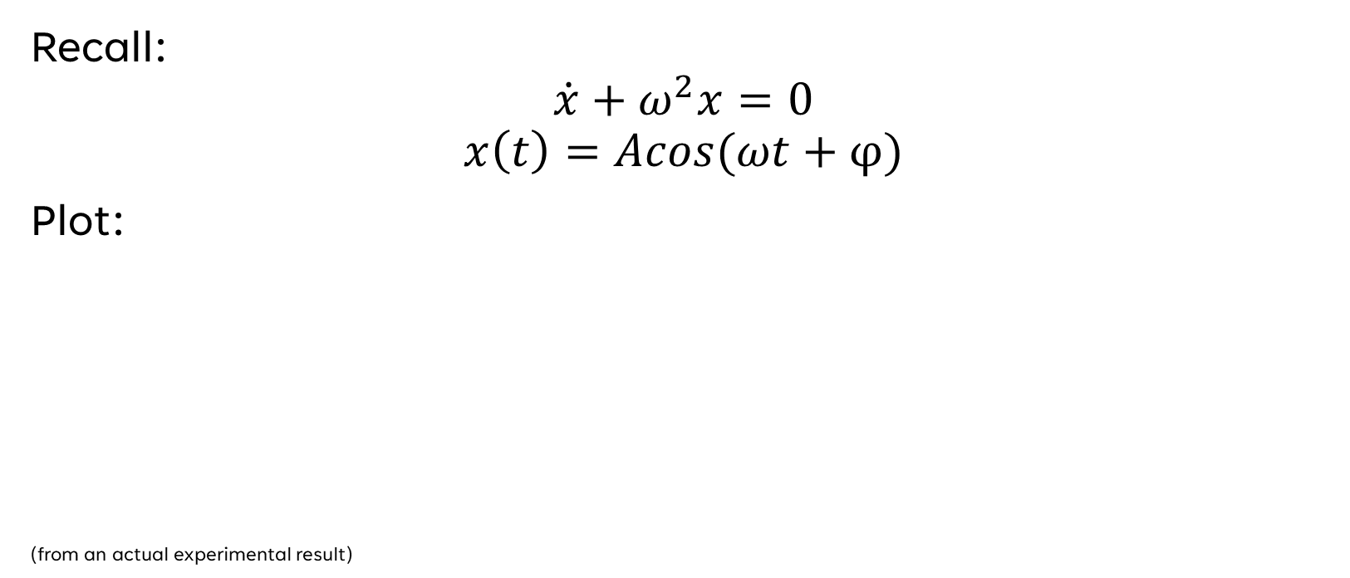
SHO:
Recall:
$$\dot{x}+ω^{2}x=0$$
$$x\left(t\right)=Acos(ωt+φ)$$
Plot:
(from an actual experimental result)

Slide 21

SHO:
$$\dot{x}+ω^{2}x=0$$
What if it is to a fractional order?
$$D^{α}x+ω^{2}x=0$$

Slide 22
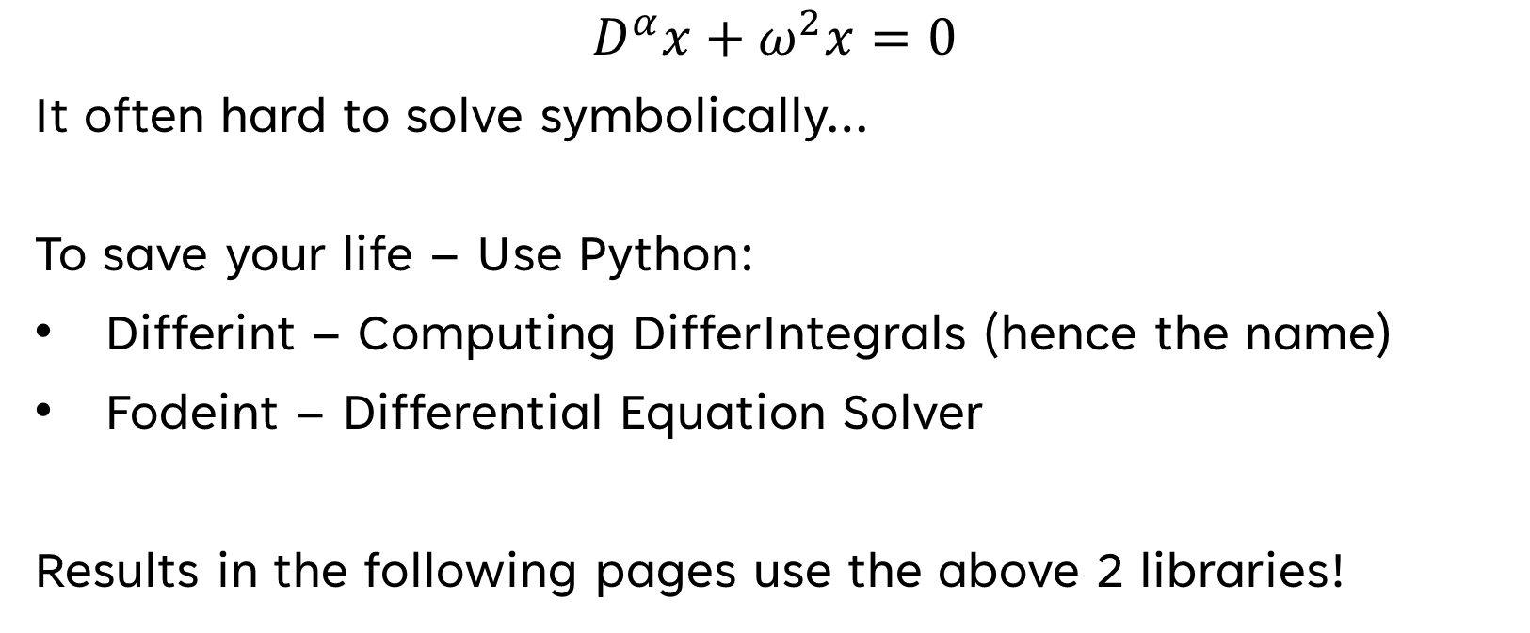
Side Note:
$$D^{α}x+ω^{2}x=0$$
It often hard to solve symbolically…
To save your life – Use Python:
Differint – Computing DifferIntegrals (hence the name)
Fodeint – Differential Equation Solver
Results in the following pages use the above 2 libraries!

Slide 23
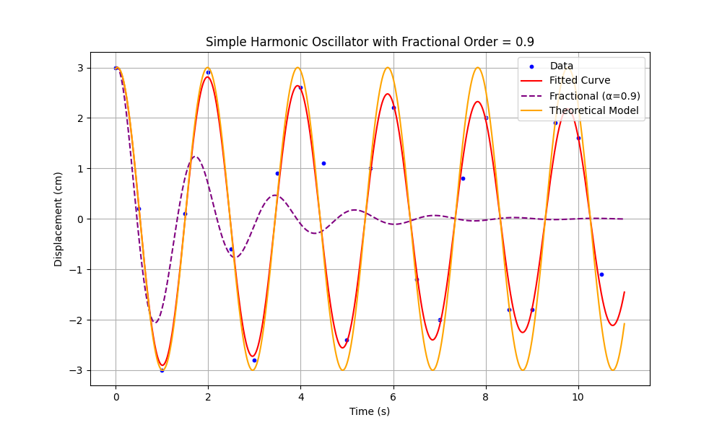
SHO Fractional:
Plot: (purple line)
Notes:
Shows the decay

Slide 24
Damping!?
Plot:
Memory Effect!!
Damped
--> but not exponential
Why?

Slide 25
Memory Effect
Mathematically:
Non-Local Operator (e.g. Fourier Transform)
Physically:
Viscous material‘s behaviour
Anomalous diffusion

Slide 26
Applying to QM
Plane Wave
Infinite Potential Wall

Slide 27
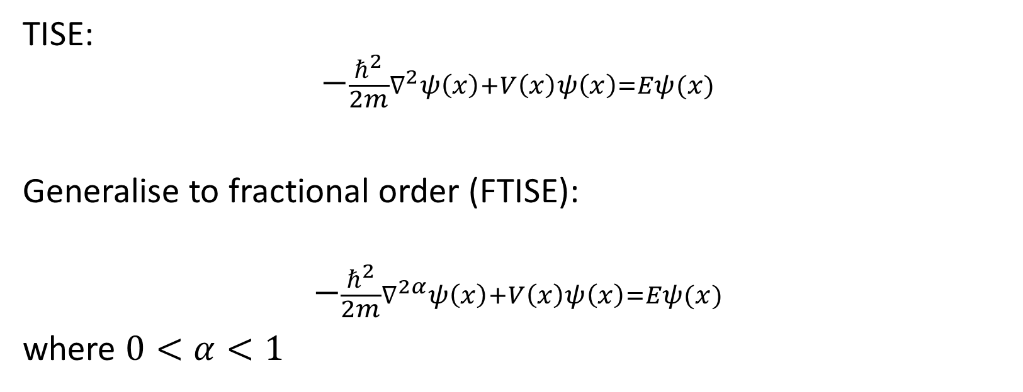
FC applied to QM
TISE:
$$−\frac{ℏ^{2}}{2m}∇^{2}ψ\left(x\right)+V\left(x\right)ψ\left(x\right)=Eψ(x)$$
Generalise to fractional order (FTISE):
$$−\frac{ℏ^{2}}{2m}∇^{2α}ψ\left(x\right)+V\left(x\right)ψ\left(x\right)=Eψ(x)$$
where $0<α<1$

Slide 28
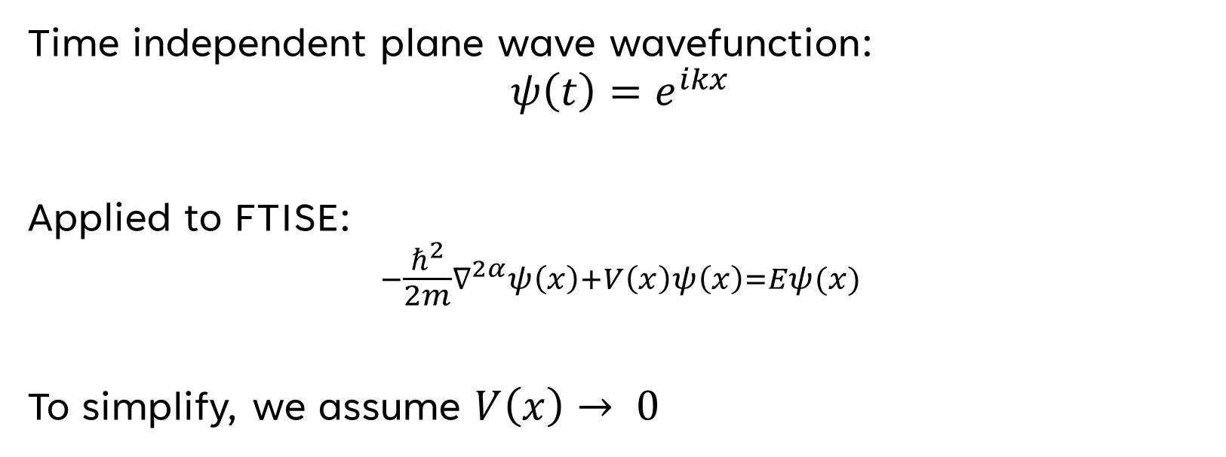
Plane Wave
Time independent plane wave wavefunction:
$$ψ\left(t\right)=e^{ikx}$$
Applied to FTISE:
$$−\frac{ℏ^{2}}{2m}∇^{2α}ψ\left(x\right)+V\left(x\right)ψ\left(x\right)=Eψ(x)$$
To simplify, we assume $V\left(x\right)→ 0$

Slide 29
Plane Wave
Recall Standard Results:

Slide 30

Plane Wave
Then:
$$∇^{2α}ψ\left(x\right)=i^{2α}k^{2α} ψ\left(x\right)$$

Slide 31

Plane Wave
Putting back into FTISE and yield:
$$−\frac{ℏ^{2}}{2m}i^{2α}k^{2α}=E$$
How to simplify further?

Slide 32
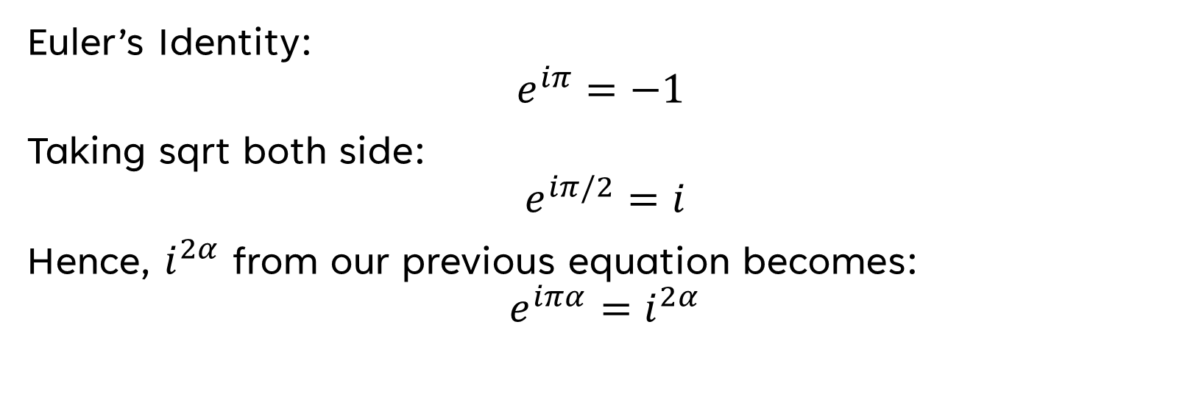
Plane Wave
Euler’s Identity:
$$e^{iπ}=−1$$
Taking sqrt both side:
$$e^{iπ/2}=i$$
Hence, $i^{2α}$ from our previous equation becomes:
$$e^{iπα}=i^{2α}$$

Slide 33

Plane Wave
$$e^{iπα}=i^{2α}$$
Hence, our expression for the eigenvalues:
$$E=−\frac{ℏ^{2}}{2m}i^{2α}k^{2α}$$
$$E=−\frac{ℏ^{2}}{2m}k^{2α}e^{iπα}$$

Slide 34
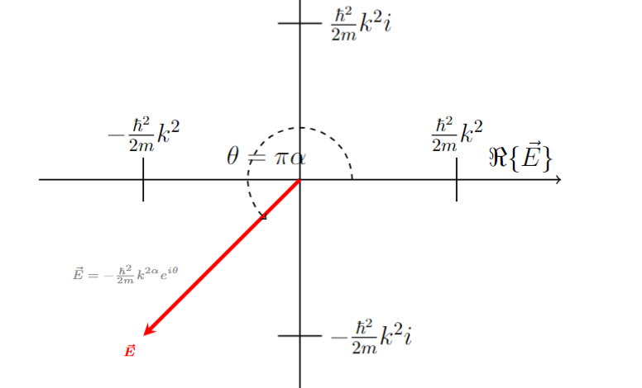
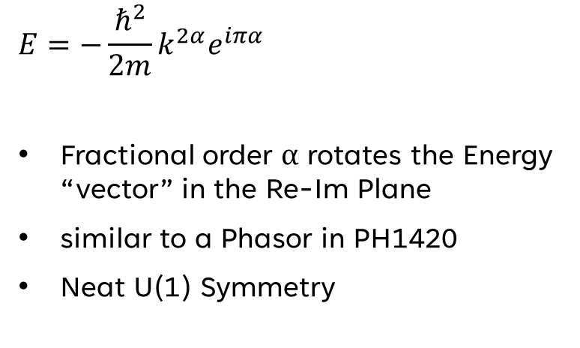
Plane Wave
Plot this on an Argand Diagram
$$E=−\frac{ℏ^{2}}{2m}k^{2α}e^{iπα}$$
Fractional order α rotates the Energy “vector” in the Re-Im Plane
similar to a Phasor in PH1420
Neat U(1) Symmetry

Slide 35
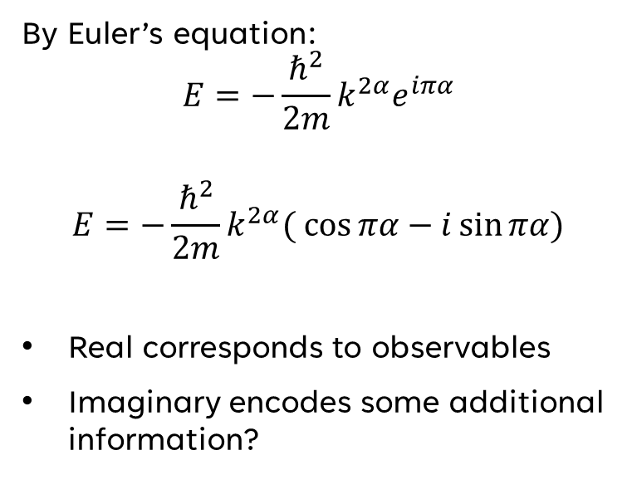
Plane Wave
Decomposed:
By Euler’s equation:
$$E=−\frac{ℏ^{2}}{2m}k^{2α}e^{iπα}$$
$$E=−\frac{ℏ^{2}}{2m}k^{2α}(\cos{πα}−i\sin{πα})$$
Real corresponds to observables
Imaginary encodes some additional information?

Slide 36
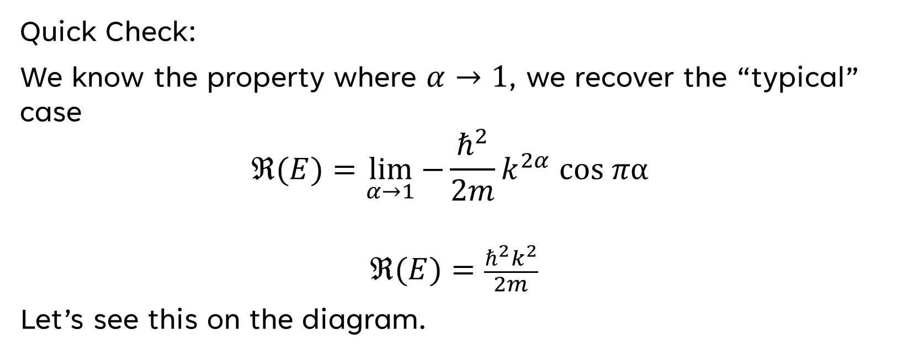
Plane Wave
Quick Check:
We know the property where $α→1$, we recover the “typical” case
$$ℜ(E)=\lim_{α→1}{−\frac{ℏ^{2}}{2m}k^{2α} \text{cos} πα }$$
$$ℜ(E)=\frac{ℏ^{2}k^{2}}{2m}$$
Let’s see this on the diagram.

Slide 37
Plane Wave

Slide 38
Plane Wave
Does this make sense?
Sort Of…

Slide 39
Plane Wave
The Hamiltonian in the Fractional order does not satisfy self-adjoint -> Non-Hermitian
Weird Properties like these are sort of expected!

Slide 40
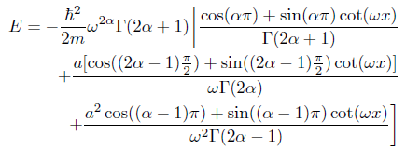
Particle in a Box
It’s Weird!
Notes:
Prove on the board:
r = a +- bi
b = k

Slide 41
Open Problems
Notes:
15 mins

Slide 42
Open Problems
Physical Interpretation?
What does the fractional derivative of something physically mean?
Does it make sense physically?
Applications to other fields
For example, in SR:
Can some order of derivative of a coefficient acts be in analogus to Lorentz Transformation?
Does this generalise to GR?

Slide 43
Summary
Notes:
15 mins

Slide 44
Summary
A topic of relatively long history but advancements are fairly recent
Definition
Common Function
Physics
Classical Mechanics: Tautochrone, SHO
QM: Plane Wave, Infinite Potential Well/Particle in a Box
Memory Effect
Strange Behaviour!
Open Problems
Physical Interpretation
Application to other fields

Slide 45
The End

